Slide 1


BATTLESNAX
By Tasneef Raza Khan

Slide 2
BATTLESNAX
Our project aims to develop a Restaurant Order Management System to streamline the process of taking and managing orders in a restaurant setting. The system will enable customers to place orders for various eatery items, while providing employees with tools to efficiently manage and fulfill those orders. The system will be built based on a database that integrates customer information, employee details, eatery item listings, and order records.

Slide 3
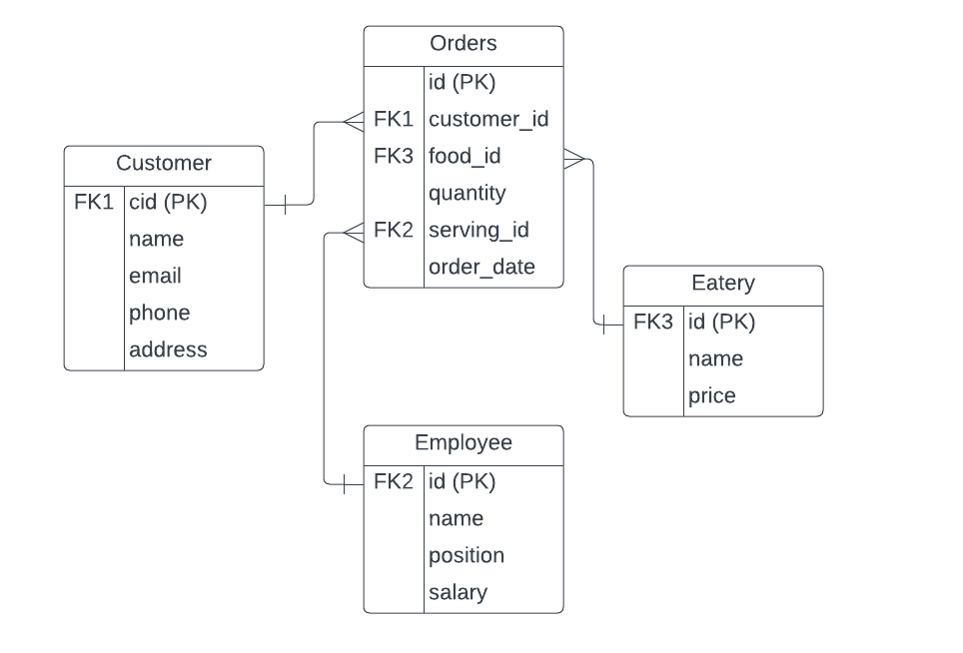
ER DIAGRAM

Slide 4
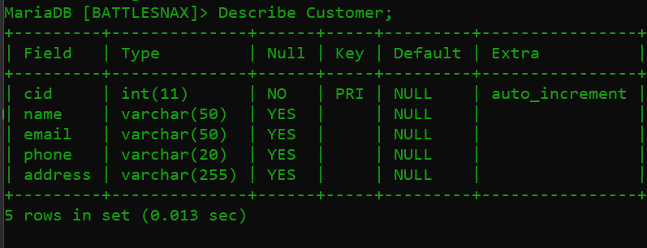
Structure of a Table
Customer Table:
The Customer table stores information about the customers who place orders in the restaurant. It serves as a repository for customer details to facilitate order management and customer relationship management.

Slide 5
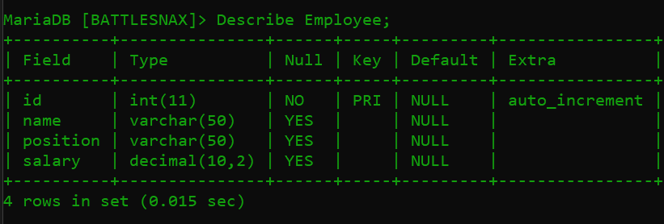
Employee Table:
The Employee table stores information about the employees working at the restaurant. It serves as a repository for employee details to facilitate employee management and assignment of roles.
Eatery Table:
The Eatery table stores information about the eatery items available at the restaurant. It serves as a repository for eatery item details to facilitate menu management and order processing.

Slide 6
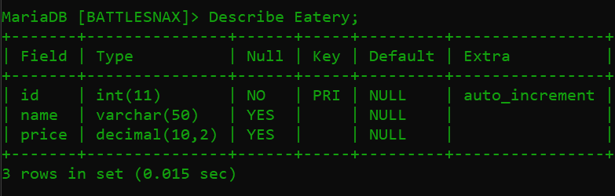
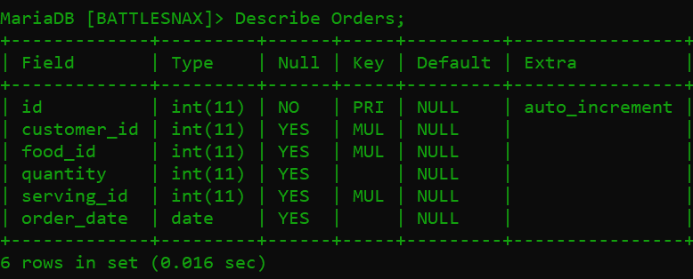
Orders Table:
The Orders table stores information about the orders placed by customers at the restaurant. It serves as a repository for order details, facilitating order management and tracking.

Slide 7
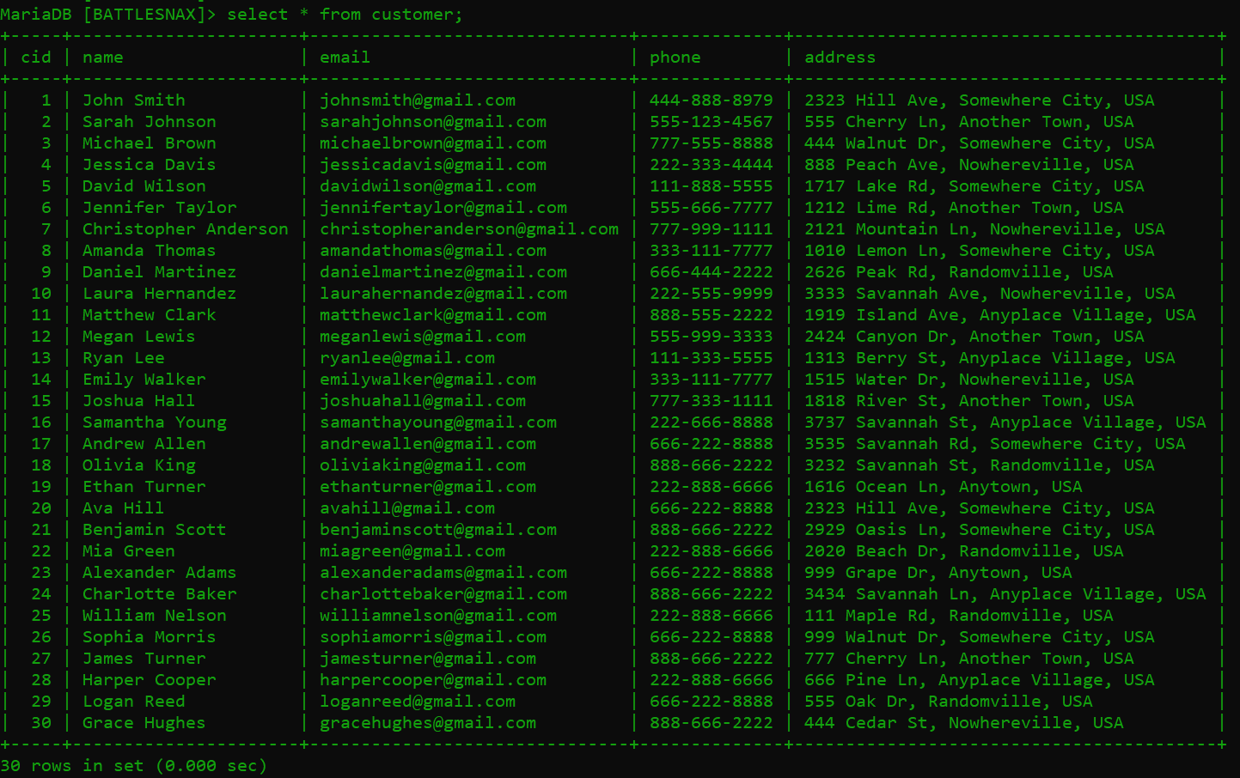
Content of a Table
Customer Table:

Slide 8
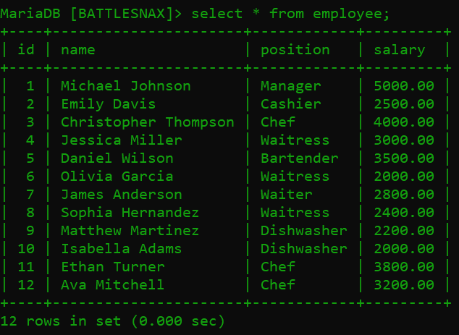
Employee Table:

Slide 9
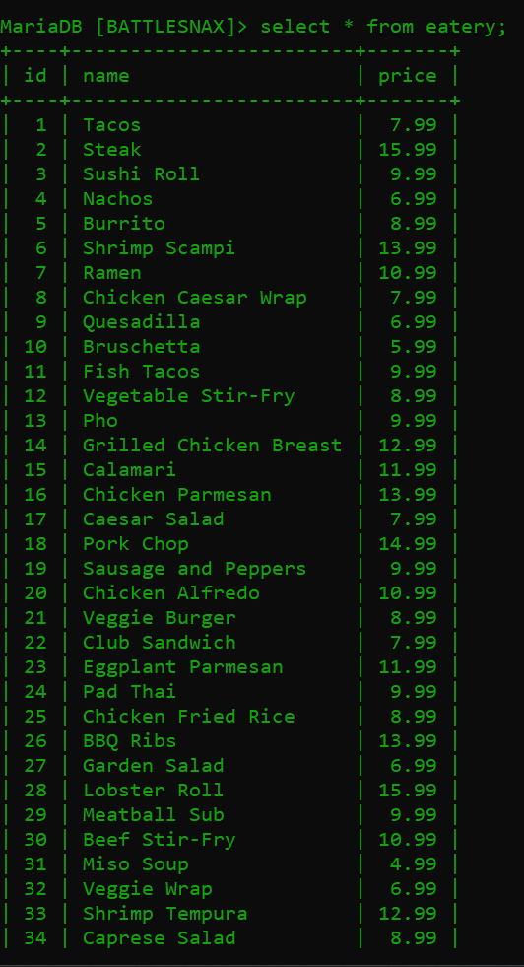
Eatery Table:

Slide 10
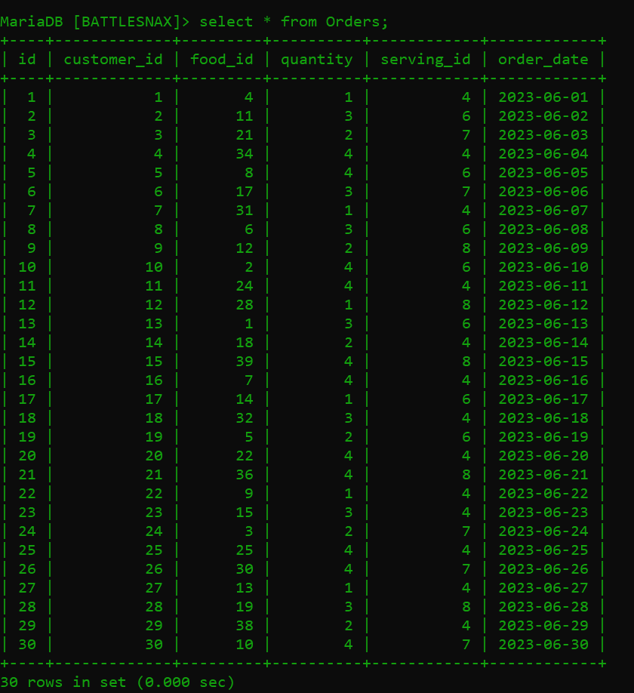
Orders Table:

Slide 11
Joins
Retrieve all orders placed by customers along with their corresponding customer information (name, email) and the eatery information (name) where the order was placed.
select o.id, c.name as customer_name, c.email, e.name as eatery_name from orders o join customer c on o.customer_id = c.cid join eatery e on o.food_id = e.id;

Slide 12
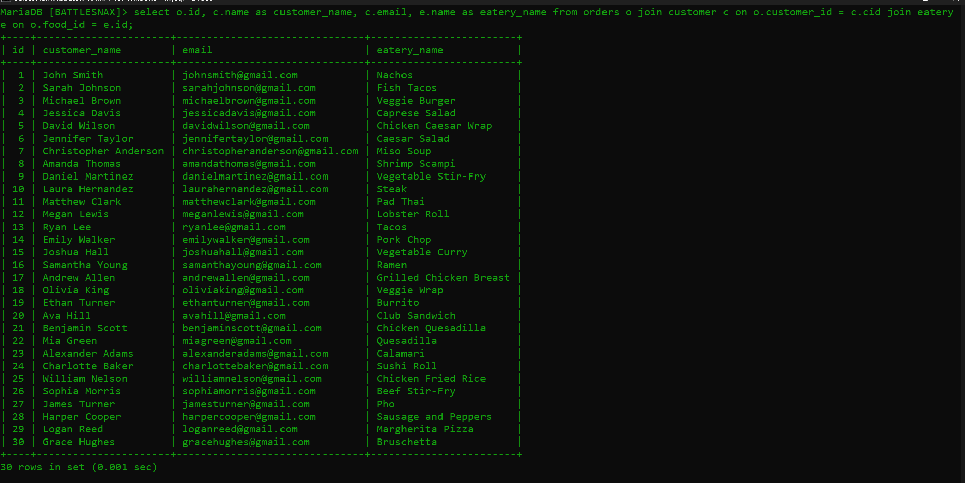

Slide 13
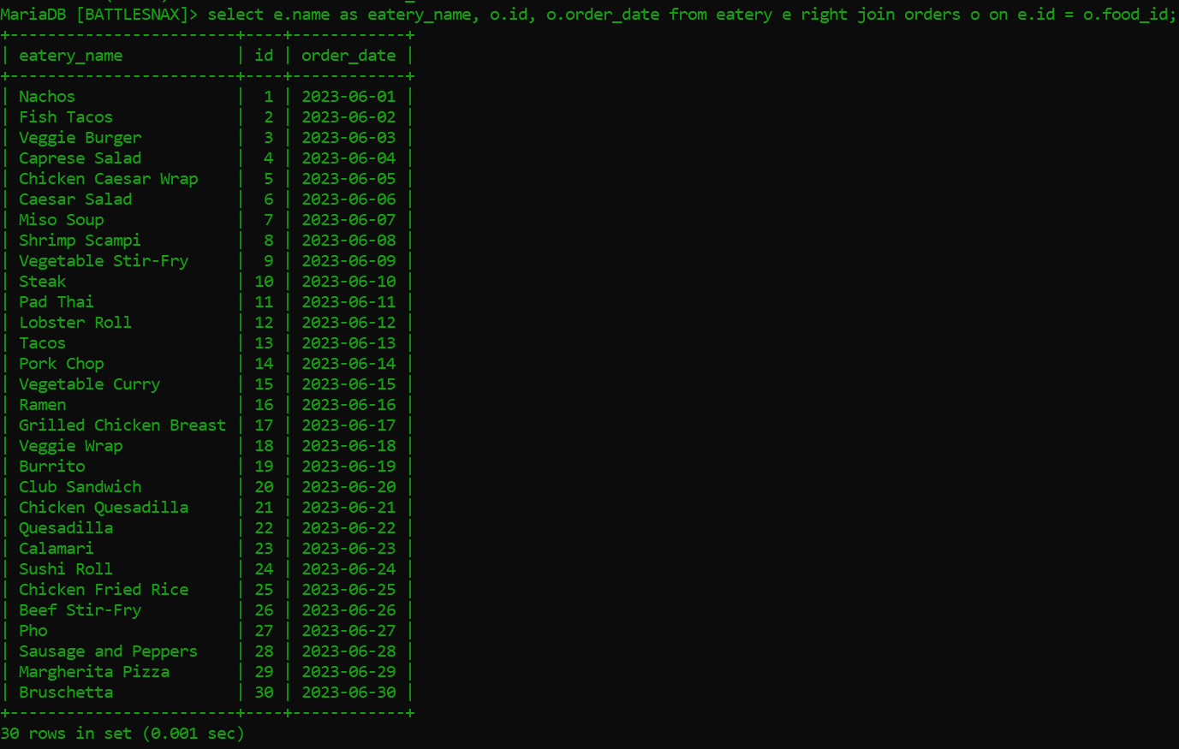
Retrieve all eatery information along with the corresponding orders (if any), including order details such as the order ID and order date.
select e.name as eatery_name, o.id, o.order_date from eatery e right join orders o on e.id = o.food_id;

Slide 14
Retrieve all orders placed by customers, including orders with no associated customer or eatery. Display the order information (order ID, order date), customer information (name, email), and eatery information (name) if available.
SELECT o.id, o.order_date, c.name AS customer_name, c.email, e.name AS eatery_name FROM Orders o LEFT JOIN Customer c ON o.customer_id = c.Cid RIGHT JOIN Eatery e ON o.food_id = e.id;

Slide 15
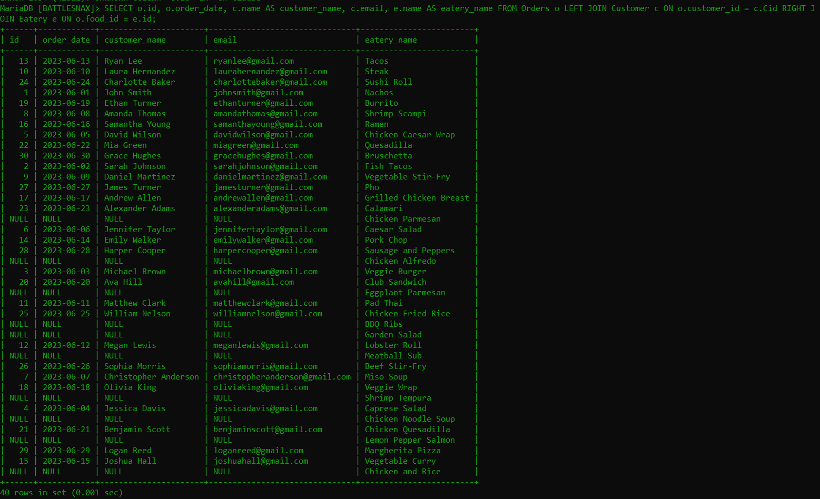

Slide 16
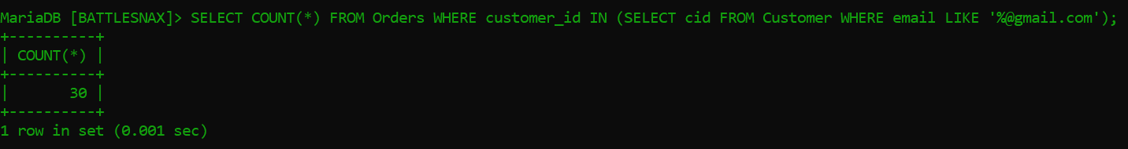
SubQueries
Fetch the total number of orders placed by customers who have a specific email domain.
SELECT COUNT(*) FROM Orders WHERE customer_id IN (SELECT cid FROM Customer WHERE email LIKE '%@gmail.com');

Slide 17
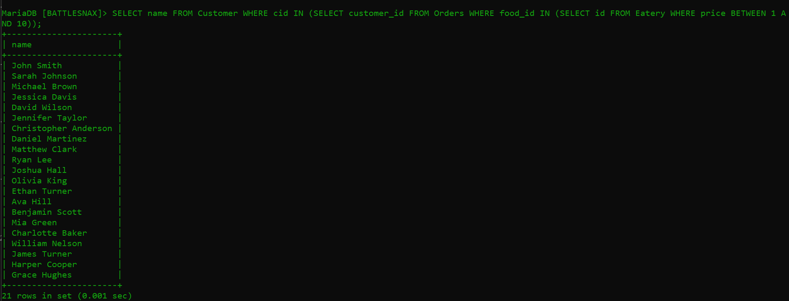
Retrieve the names of customers who have placed orders for eatery items with a specific price range.
SELECT name FROM Customer WHERE cid IN (SELECT customer_id FROM Orders WHERE food_id IN (SELECT id FROM Eatery WHERE price BETWEEN 1 AND 10));

Slide 18
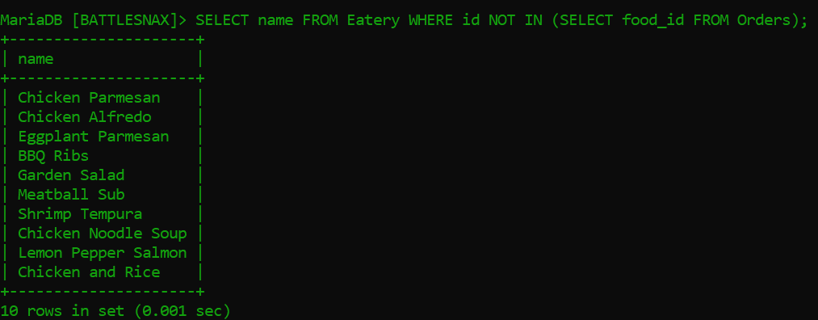
Retrieve the names of eatery items (from the Eatery table) that have never been ordered by any customer.
SELECT name FROM Eatery WHERE id NOT IN (SELECT food_id FROM Orders);

Slide 19
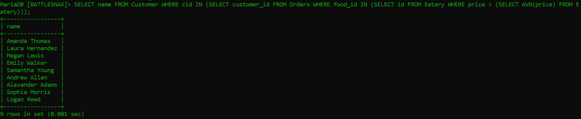
Retrieve the names of customers who have placed orders for eatery items with a price higher than the average price of all eatery items.
SELECT name FROM Customer WHERE cid IN (SELECT customer_id FROM Orders WHERE food_id IN (SELECT id FROM Eatery WHERE price > (SELECT AVG(price) FROM Eatery)));

Slide 20
THE END THANK YOU

